Slide 1
Convolutional Neural Networks (CNNs)
CS 4710
April 17, 2019

Slide 2
Correction
Correction for dropout

Slide 3
Correction
Correction for dropout
Last time: said dropout happens once during training (whoops)

Slide 4
Correction
Correction for dropout
Last time: said dropout happens once during training (whoops)
Reread original paper: happens randomly throughout training (is ignored)

Slide 5
Correction
Correction for dropout
Last time: said dropout happens once during training (whoops)
Reread original paper: happens randomly throughout training (is ignored)
Intuition:

Slide 6
Correction
Correction for dropout
Last time: said dropout happens once during training (whoops)
Reread original paper: happens randomly throughout training (is ignored)
Intuition:
Randomly ignoring weights during training prevents net from relying on some particular configuration of weights

Slide 7
Correction
Correction for dropout
Last time: said dropout happens once during training (whoops)
Reread original paper: happens randomly throughout training (is ignored)
Intuition:
Randomly ignoring weights during training prevents net from relying on some particular configuration of weights
This forces generalization

Slide 8
Before we start . . .
Neural networks tend to be studied from 1 of 2 perspectives:

Slide 9
Before we start . . .
Neural networks tend to be studied from 1 of 2 perspectives:
Machine learning (use: practical application)

Slide 10
Before we start . . .
Neural networks tend to be studied from 1 of 2 perspectives:
Machine learning (use: practical application)
Neurosciences (use: analogical modeling)

Slide 11
Before we start . . .
Neural networks tend to be studied from 1 of 2 perspectives:
Machine learning (use: practical application)
Neurosciences (use: analogical modeling)
Convolutional neural networks are a prime example of this

Slide 12
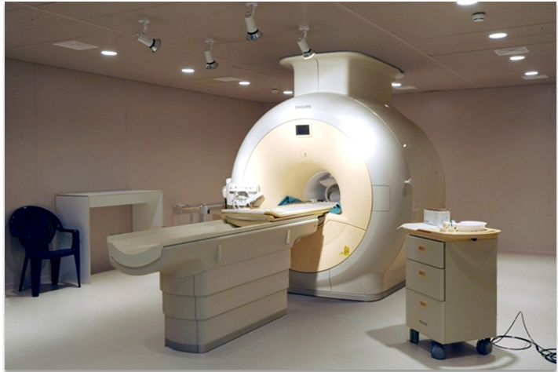

Slide 13
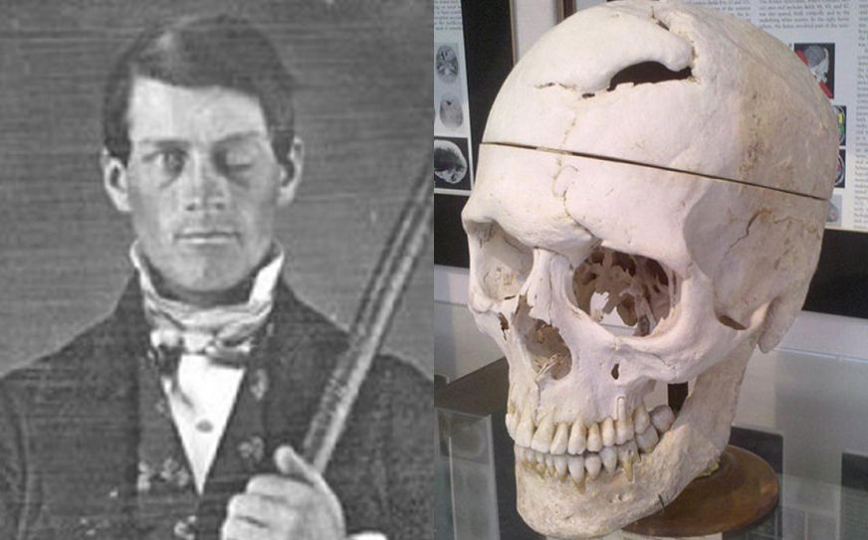

Slide 14
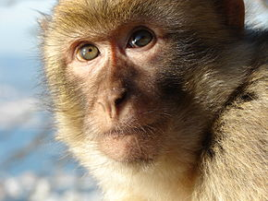

Slide 15
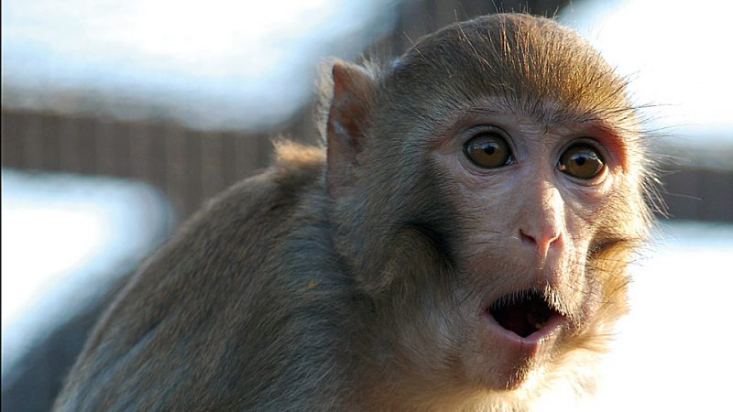

Slide 16
Hubel & Wiesel (1968)

Slide 17
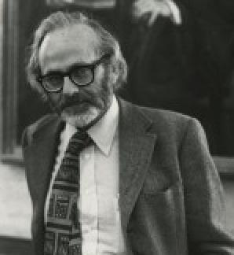
Hubel & Wiesel (1968)

Slide 18
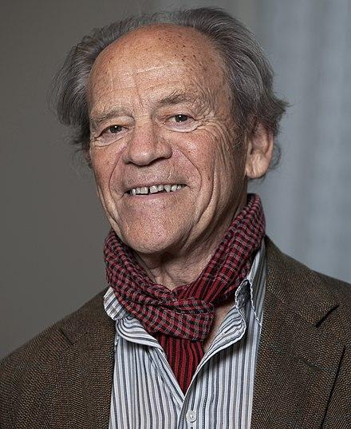
Hubel & Wiesel (1968)

Slide 19
Today’s structure
CNN architecture
Convolutional layer
Pooling layer
Computer vision applications
Classification
Object detection
Semantic segmentation
Extended applications
Audio analysis
Natural language processing

Slide 20
CNN Architecture

Slide 21
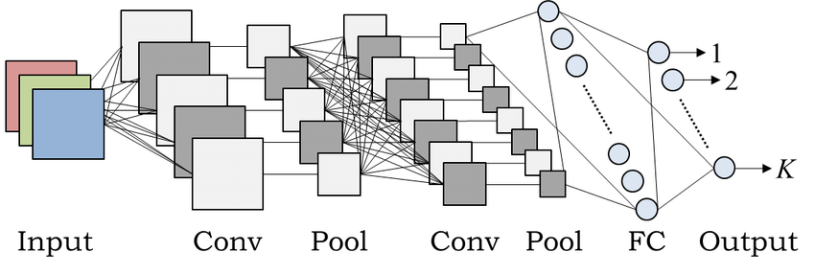

Slide 22
2 new layers: conv and pool

Slide 23
2 new layers: conv and pool
CNN is a feature extractor (output: k-length feature vector)

Slide 24
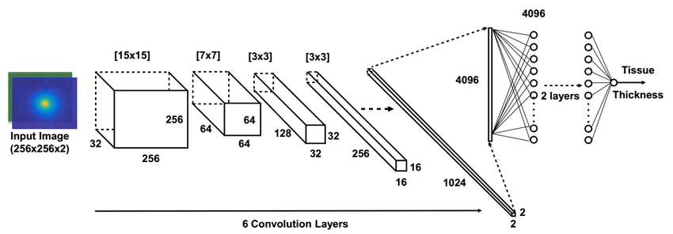

Slide 25
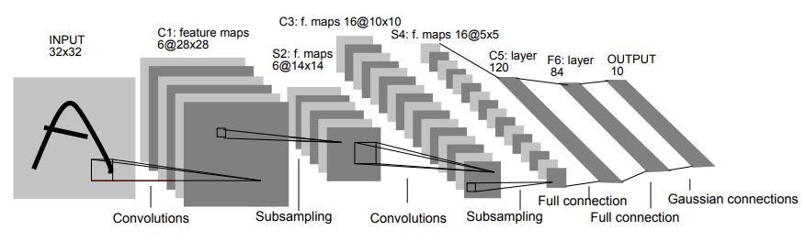


Slide 26
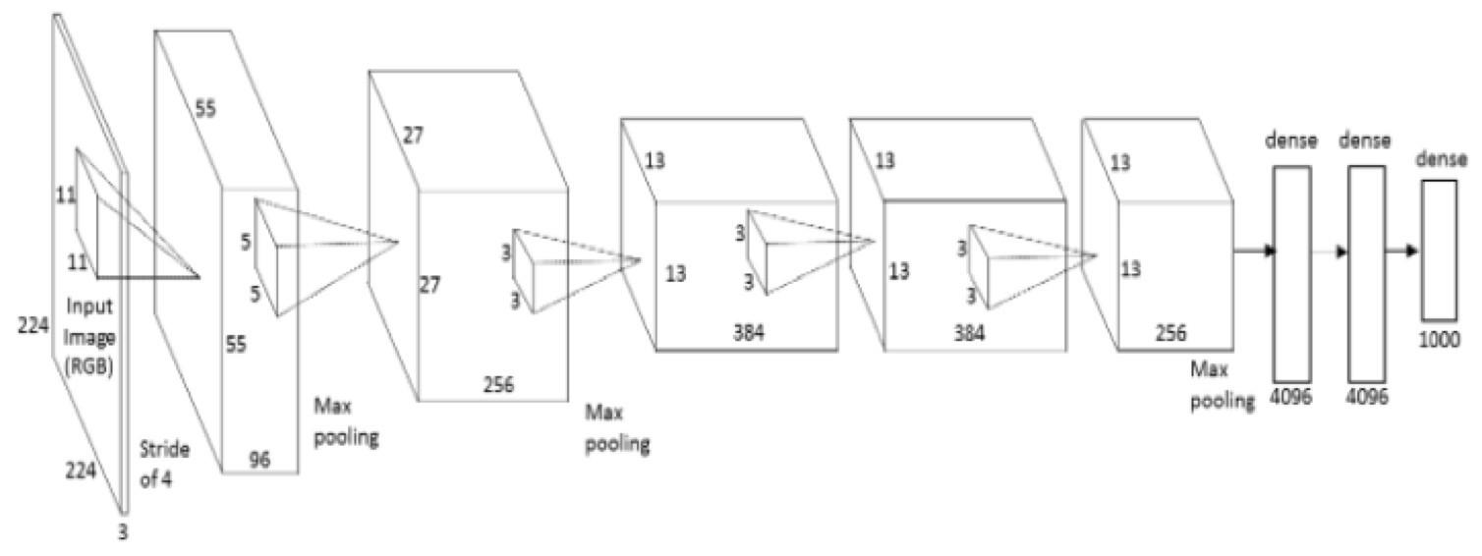

Slide 27
Convolution layer

Slide 28
Convolution layer
Window size (width, height)

Slide 29
Convolution layer
Window size (width, height)
Step size (number of “pixels”)

Slide 30
Convolution layer
Window size (width, height)
Step size (number of “pixels”)

Slide 31
Convolution layer
Window size (width, height)
Step size (number of “pixels”)

Slide 32
Convolution layer
Window size (width, height)
Step size (number of “pixels”)

Slide 33
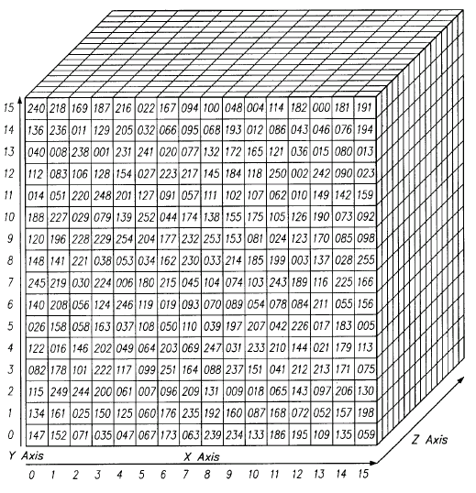
Filters visualized

Slide 34
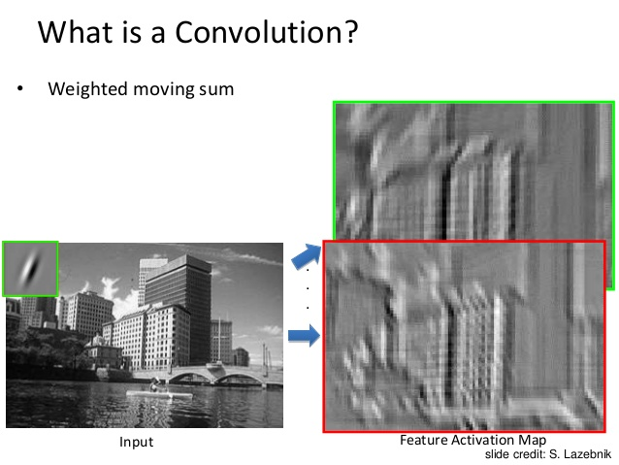
Filters visualized

Slide 35
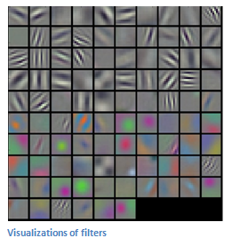
Filters visualized

Slide 36
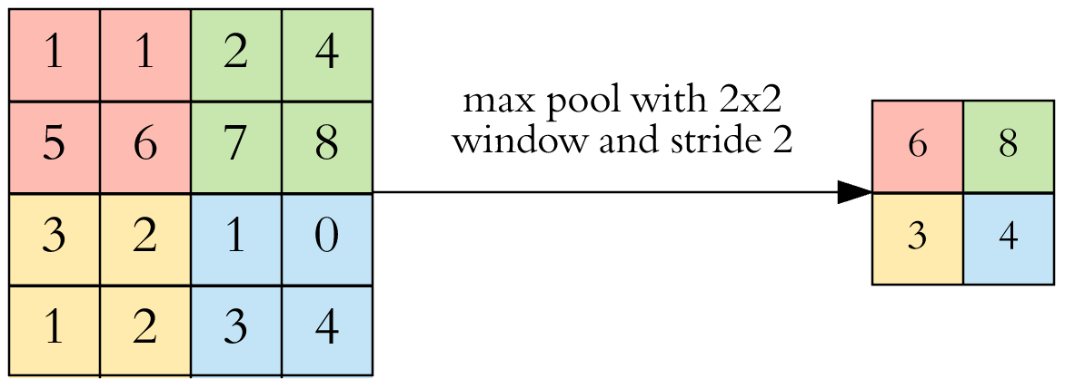
Pooling layer (“downsampling”)
Similar to convolution
Params: window size, step size, function
Fixed function chosen ahead of time
Examples: average, max

Slide 37
Stepping back . . .

Slide 38
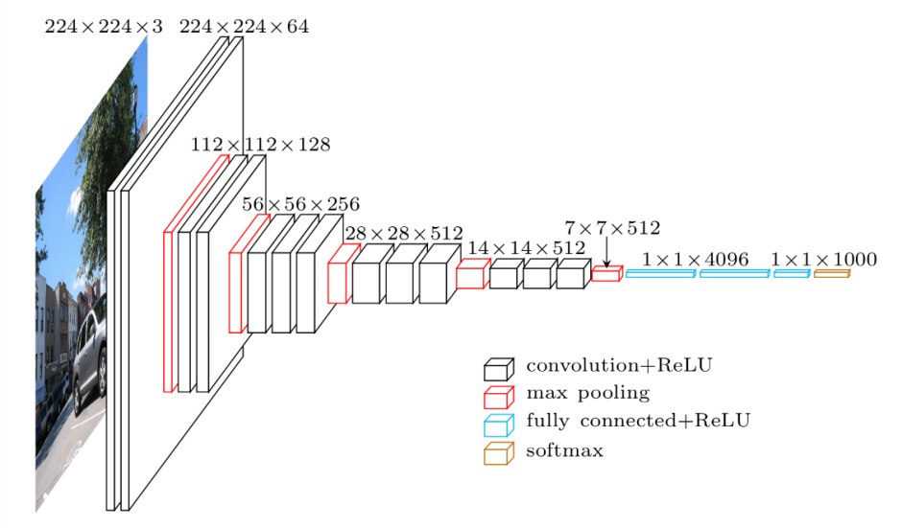
Stepping back . . .

Slide 39
Stepping back . . .
Conv layer makes features

Slide 40
Stepping back . . .
Conv layer makes features
Pool layer summarizes

Slide 41
Applications (computer vision)

Slide 42
Image classification

Slide 43
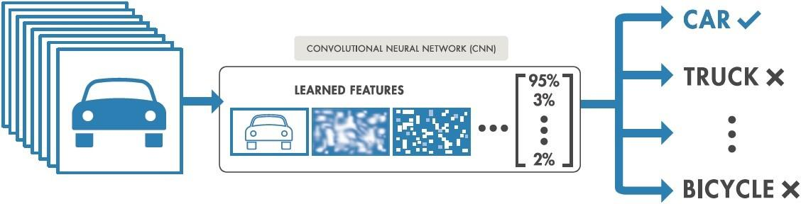
Image classification

Slide 44
Image classification
Outputs 1 class for entire image

Slide 45
Image classification
Outputs 1 class for entire image
Supposedly “invariant” to certain image transformations

Slide 46
Image classification
Outputs 1 class for entire image
Supposedly “invariant” to certain image transformations (mileage may vary)

Slide 47
Image classification
Outputs 1 class for entire image
Supposedly “invariant” to certain image transformations (mileage may vary)
Translation
Scaling

Slide 48
Object detection

Slide 49
Object detection
Predict class and a bounding box (axis-aligned)

Slide 50
Object detection
Predict class and a bounding box (axis-aligned)
Location + Dimensions (x,y,w,h)

Slide 51
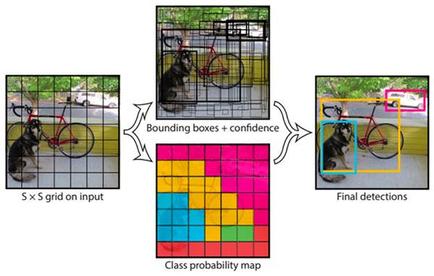
Object detection
Predict class and a bounding box (axis-aligned)
Location + Dimensions (x,y,w,h)

Slide 52

Object detection
Predict class and a bounding box (axis-aligned)
Location + Dimensions (x,y,w,h)

Slide 53
Semantic segmentation

Slide 54
Semantic segmentation
Pixel-wise prediction of object class

Slide 55
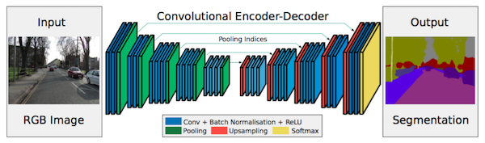
Semantic segmentation
Pixel-wise prediction of object class

Slide 56
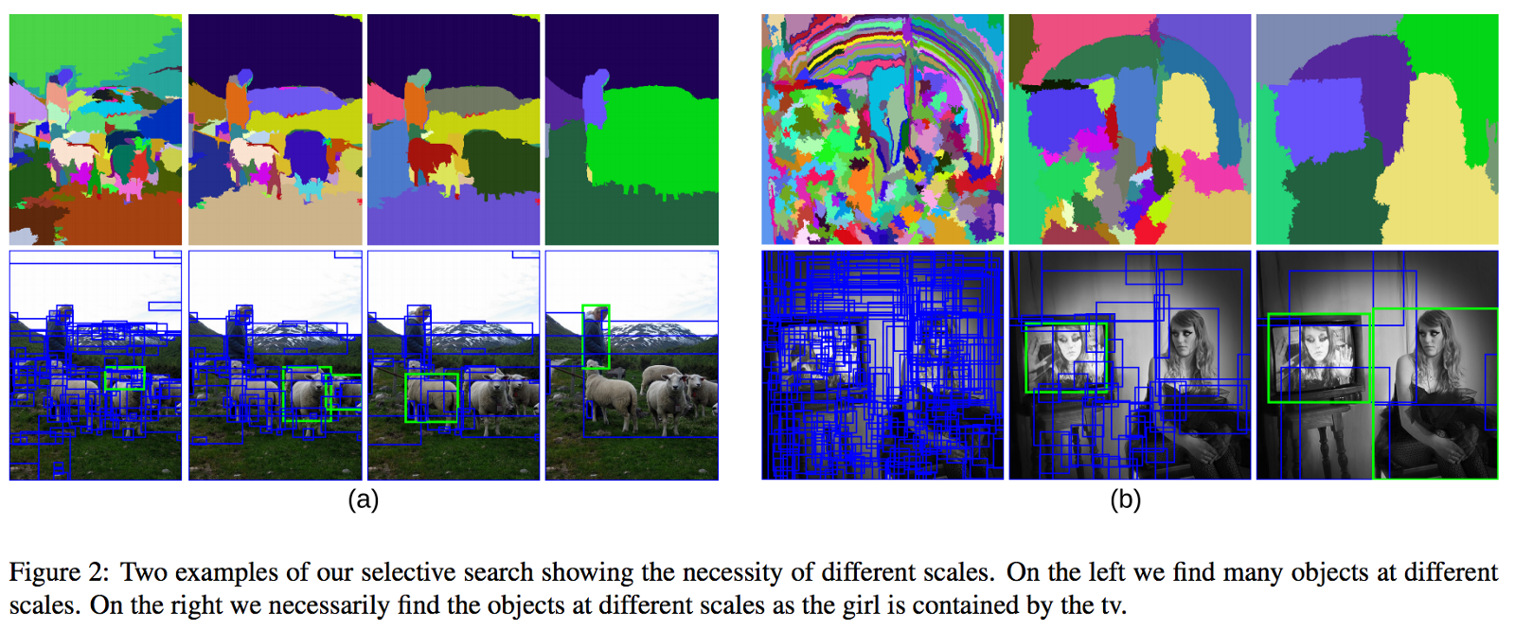
Semantic segmentation
Pixel-wise prediction of object class

Slide 57
Extended applications (non-computer vision)

Slide 58
Extended applications (non-computer vision)
Main shtick:

Slide 59
Extended applications (non-computer vision)
Main shtick:
Transform input into 2D matrix (or image) of some sort

Slide 60
Extended applications (non-computer vision)
Main shtick:
Transform input into 2D matrix (or image) of some sort
Apply standard computer vision techniques

Slide 61
Audio analysis (classifying sound)

Slide 62
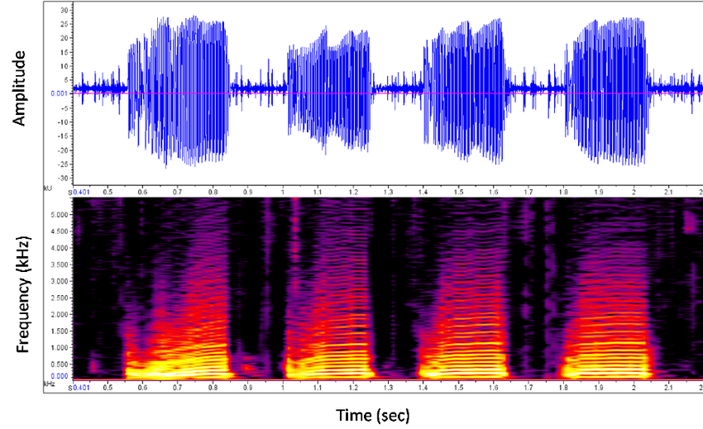
Audio analysis (classifying sound)

Slide 63
Audio analysis (classifying sound)
Fast Fourier Transform
(FFT)

Slide 64
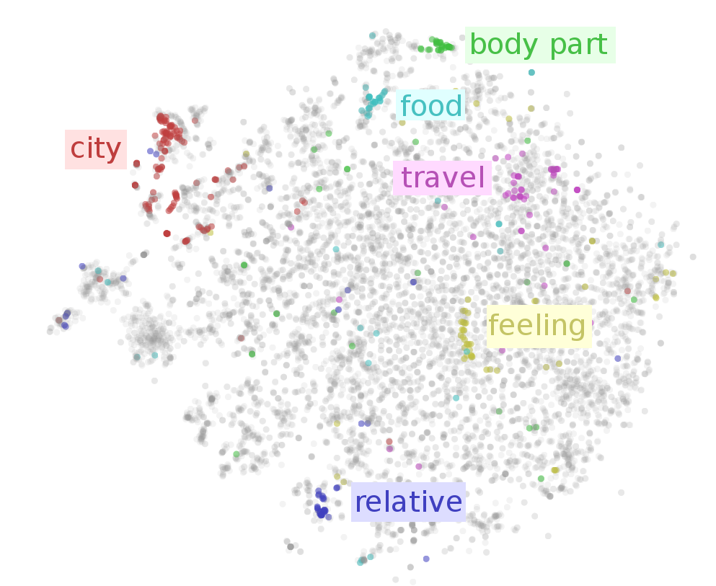
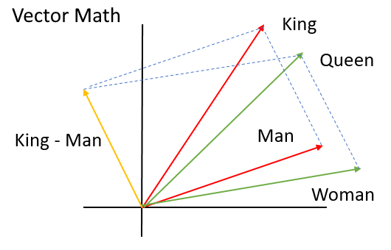
Natural language processing
Concept: word embeddings

Slide 65
Some links
https://adeshpande3.github.io/A-Beginner%27s-Guide-To-Understanding-Convolutional-Neural-Networks/
https://www.tensorflow.org/tutorials/keras/basic_classification ← coding tutorial
https://medium.freecodecamp.org/an-intuitive-guide-to-convolutional-neural-networks-260c2de0a050
http://deeplearning.stanford.edu/tutorial/supervised/ConvolutionalNeuralNetwork/
https://skymind.ai/wiki/convolutional-network ← lots of links to original papers here
https://www.slideshare.net/jbhuang/lecture-29-convolutional-neural-networks-computer-vision-spring2015
https://engmrk.com/lenet-5-a-classic-cnn-architecture/
Monkey brains: https://www.ncbi.nlm.nih.gov/pmc/articles/PMC1557912/
https://towardsdatascience.com/applied-deep-learning-part-4-convolutional-neural-networks-584bc134c1e2
http://blog.qure.ai/notes/semantic-segmentation-deep-learning-review

